Slide 1

Deep Learning Techniques for Activity Recognition: Dealing With Inactivity
Matteo Drago, Riccardo Lincetto
Dept. of Information Engineering, University of Padova, Italy
Prof. Michele Rossi
matteo.drago@studenti.unipd.it
riccardo.lincetto@studenti.unipd.it
September, 5, 2018

Slide 2
Outline
Introduction
Dataset description
Related Work
Our proposal
Discussion of results
Conclusion and future works

Slide 3
Introduction
Human Activity Recognition:
Visual detection from images and video
Gesture recognition from sensor-based data
In the past decade, many models have been designed for time series classification.
Main problems:
LACK of BENCHMARKING DATASET to compare different solutions
ABSENCE of DETAILS in most of the models presented in the literature

Slide 4
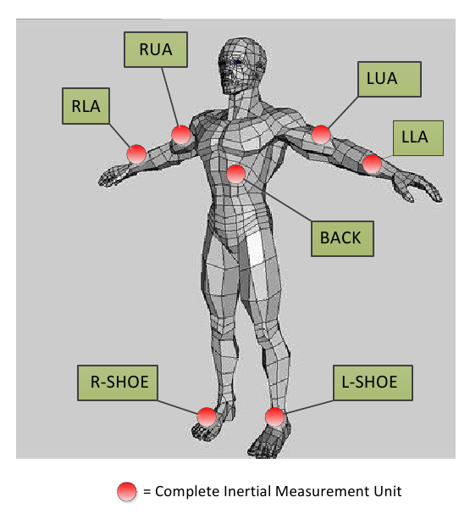
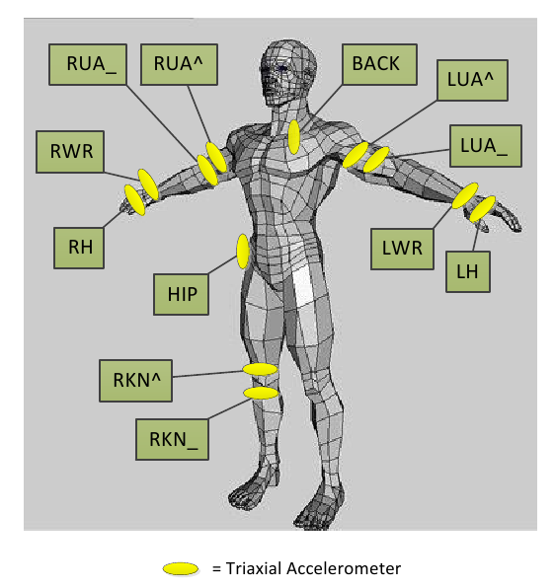
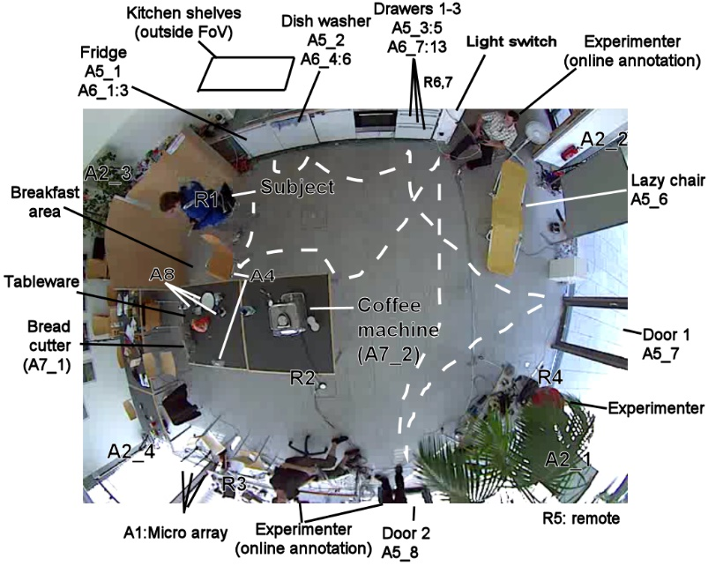
OPPORTUNITY DATASET
[1] R. Chavarriaga, H. Sagha, A. Calatroni, S. T. Digumarti, G. Tröster, J. del R. Millán, and D. Roggen, “The opportunity challenge: A benchmark database for on-body sensor-based activity recognition,” Pattern Recognition Letters, 2013.

Slide 5
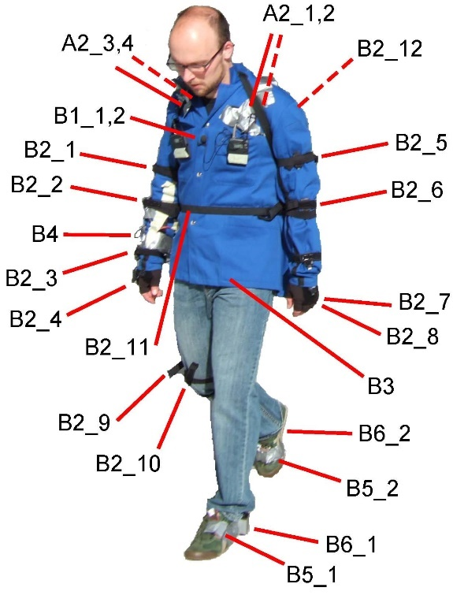
4 different subjects
7 Inertial Measurement Units
12 accelerometer sensors
113 channels of measurements
Data has been collected in two distinct modalities :
5 sessions of Activity of Daily Living (ADL)
Drill : 20 repetitions of low level activities

Slide 6
Multiclass Classification Problem
TASK A:
Classification of high level gestures / modes of locomotion
Standing, Walking, Lying, Sitting
TASK B2:
Recognition of low level gestures (17 in total)
Open Dishwasher, Close Dishwasher, Open Fridge, Close Fridge,
Open Drawer 1, Close Drawer 1, Open Door 1, Close Door 1, …
Both tasks comprehend the Null Class, which represents inactivity.
A more detailed discussion on this in a couple of slides

Slide 7
State of the Art
In the literature there’s no shortage of models trying to solve the problem. For example:
Complete framework in [2] that performs interpolation in preprocessing and tries to cope with class imbalances (1NN and SVM as classifiers)
Convolutional layers were implemented in NN along with ReLU and pooling layers in [3], in order to extract better features; they also segment the datasets into windows of samples
A complete comparison can be found in [4] were they also implement a model comprehensive of both convolutional and LSTM layers, in order to extract sensible features and exploit the correlation among consecutive samples and independent windows
[2] H. Cao, M. N. Nguyen, C. Phua, S. Krishnaswamy, and X. Li, “An integrated framework for human activity classification.,” in UbiComp,pp. 331–340, 2012.
[3] J. Yang, M. N. Nguyen, P. P. San, X. Li, and S. Krishnaswamy, “Deep convolutional neural networks on multichannel time series for human activity recognition.,” in Ijcai, vol. 15, pp. 3995–4001, 2015.
[4] F. Li, K. Shirahama, M. A. Nisar, L. Köping, and M. Grzegorzek, “Comparison of feature learning methods for human activity recognition using wearable sensors,” Sensors, vol. 18, no. 2, p. 679, 2018.

Slide 8
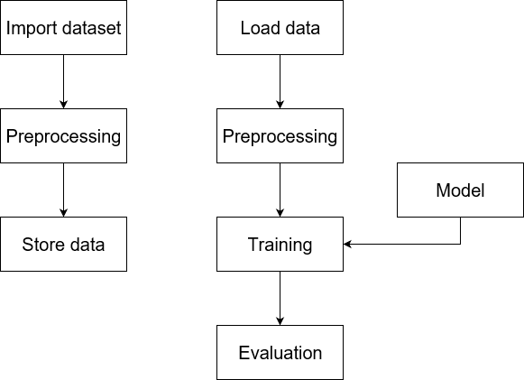
Processing Pipeline of Our Proposal
Matlab
Python

Slide 9
Preprocessing
Original dataset (Dark squares = NaN values)
ADL2
time

Slide 10
Preprocessing
Discard of useless columns, keeping on-body sensor signals
ADL2
time

Slide 11
Preprocessing
Cutting of initial and final NaNs
ADL2
time

Slide 12
Preprocessing
Interpolation
ADL2
time

Slide 13
Preprocessing
Concatenation
ADL1
ADL2
ADL3
time

Slide 14
Preprocessing
Setting Nan columns to zero
ADL1
ADL2
ADL3
time

Slide 15
Preprocessing
Normalization
ADL1
ADL2
ADL3
time

Slide 16
Preprocessing
Shaping (windowing)
ADL1
ADL2
ADL3
time

Slide 17
Preprocessing
Shaping (windowing)
window size
# windows
# features
Training set | ADL1 | Test set | ADL4
 | ADL2 |  | ADL5
 | ADL3
 | Drill

Slide 18
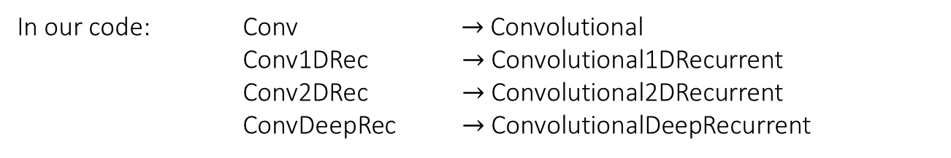
Models
Layer type \ Model name |  | Convolutional | Recurrent (LSTM) | Fully connected
Conv |  | 3 | 0 | 2
Conv1DRec |  | 1 | 2 | 2
Conv2DRec |  | 1 | 2 | 2
ConvDeepRec |  | 3 | 2 | 2
In our code: Conv $→$Convolutional
Conv1DRec $→$Convolutional1DRecurrent
Conv2DRec $→$Convolutional2DRecurrent
ConvDeepRec $→$ConvolutionalDeepRecurrent

Slide 19
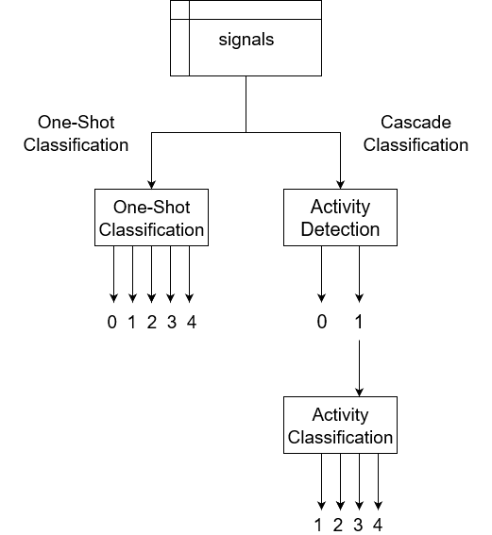
Pipelines
3 types of classification for each model:
One-Shot
Classification (n+1 class)
Cascade
Activity detection (binary)
Activity classification (n-class)

Slide 20
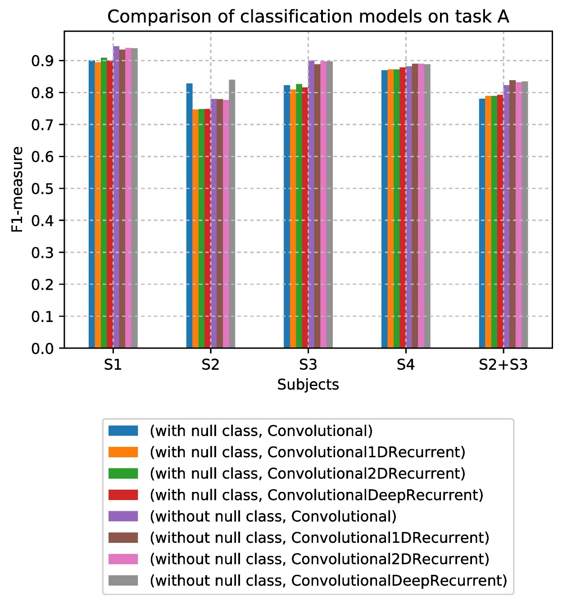
Results on locomotion
One-Shot vs Activity classification

Slide 21
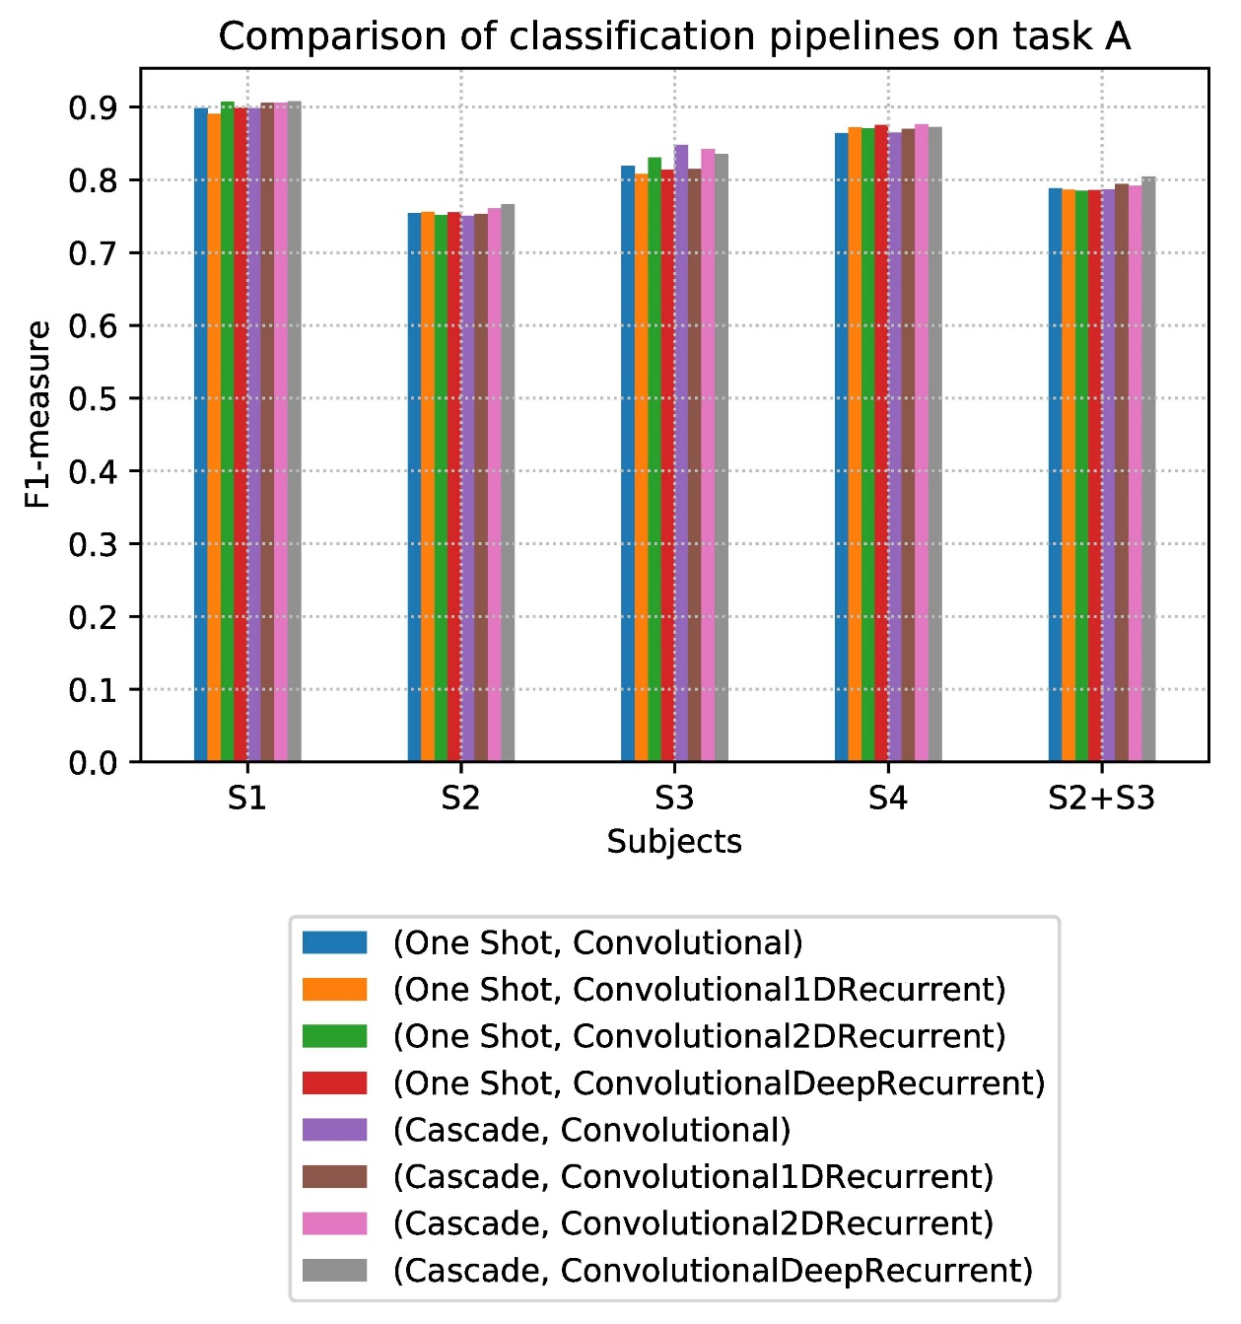
Results on locomotion
One-Shot vs Cascade classification

Slide 22
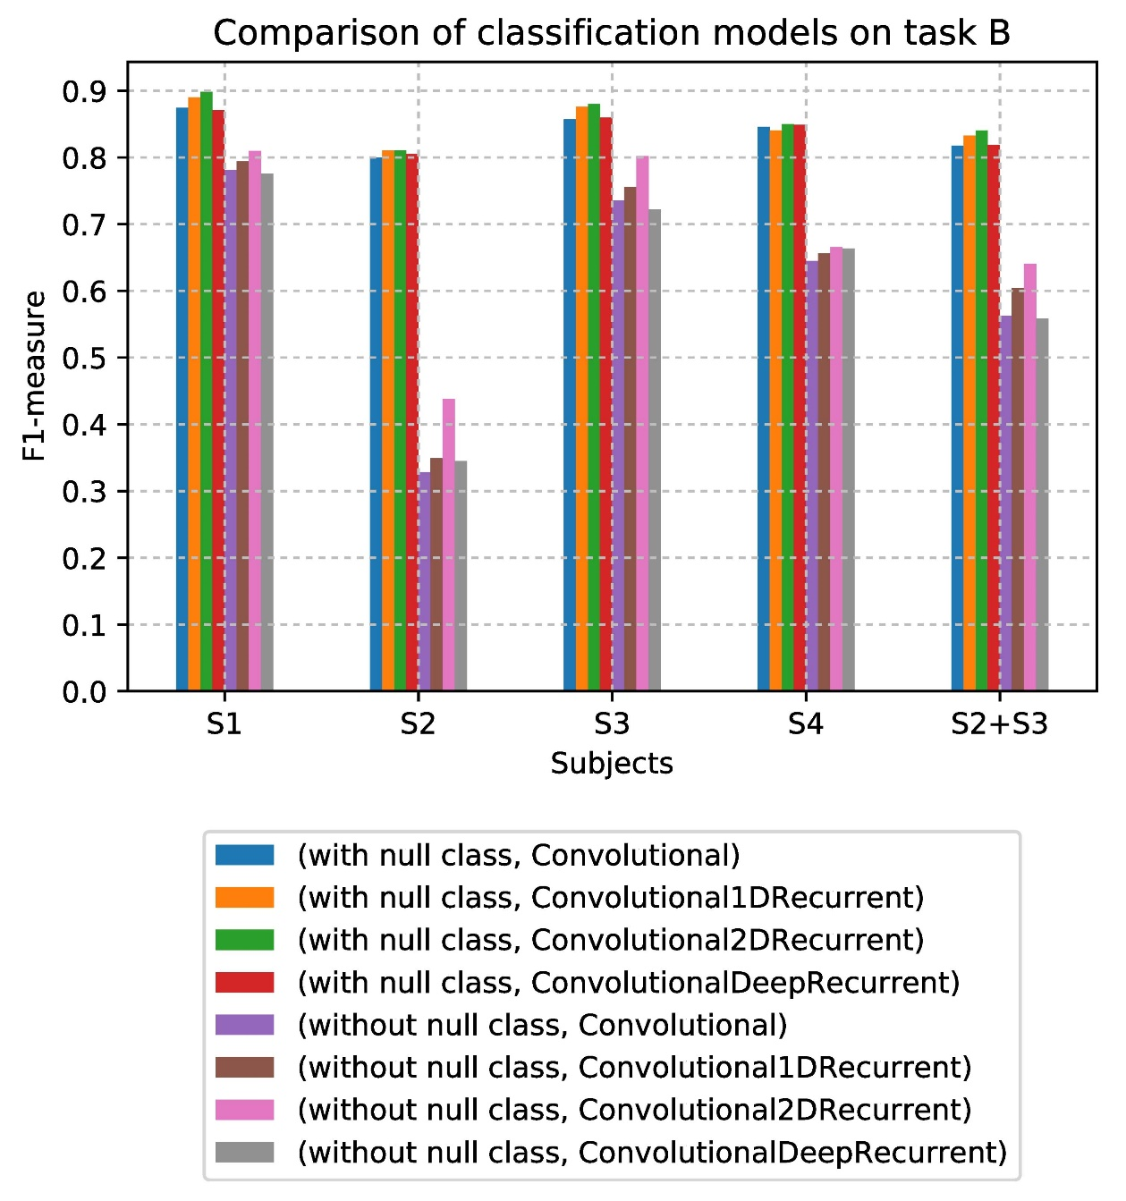
Results on gestures
One-Shot vs Activity classification

Slide 23

Results on gestures
One-Shot vs Cascade classification

Slide 24
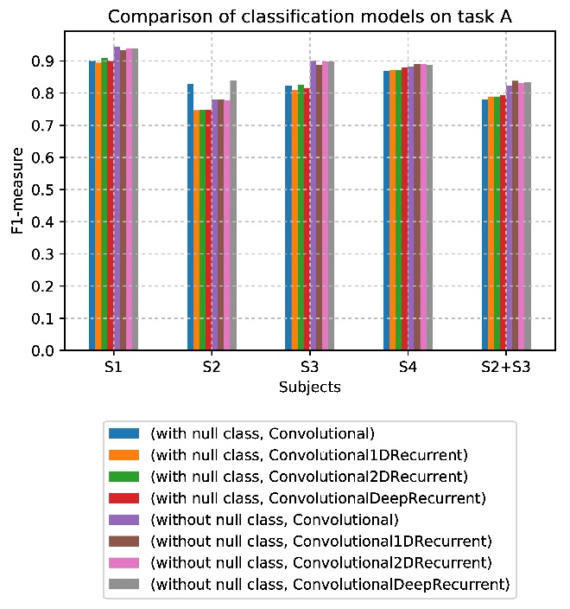
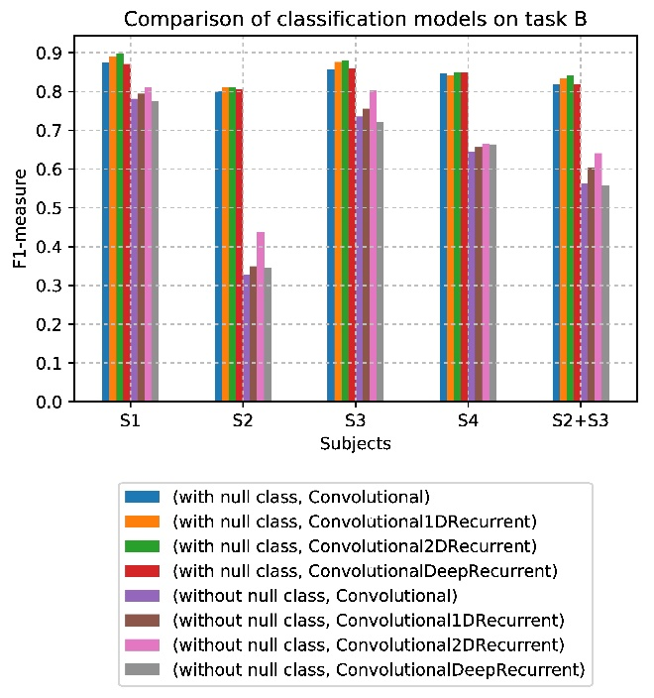
Conclusions
No clear best choice
Class imbalance
Cascade implementation … notebook
These problems could be addressed in future work

Slide 25
Deep Learning Techniques for Activity Recognition: Dealing With Inactivity
Matteo Drago, Riccardo Lincetto
Dept. of Information Engineering, University of Padova, Italy
Prof. Michele Rossi
matteo.drago@studenti.unipd.it
riccardo.lincetto@studenti.unipd.it
September, 5, 2018

